Slide 1
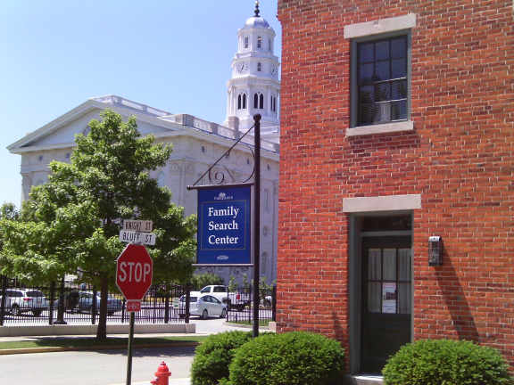
The Heart of Genealogy

Slide 2
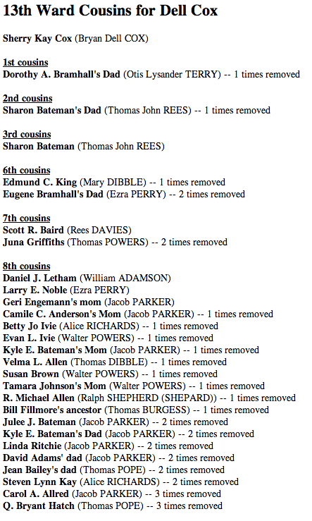
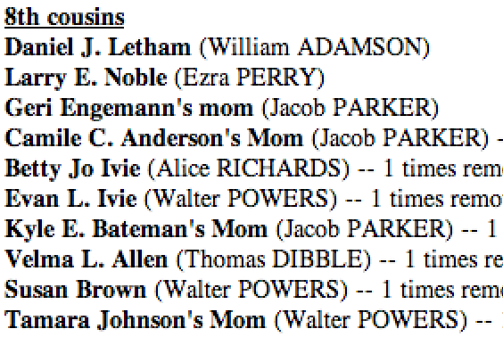

Slide 3
General Authorities Cousins
GenTech presentation on algorithms and structures for finding relationship
About 80 General Authorities and their wives
Over half responded with gratitude

Slide 4
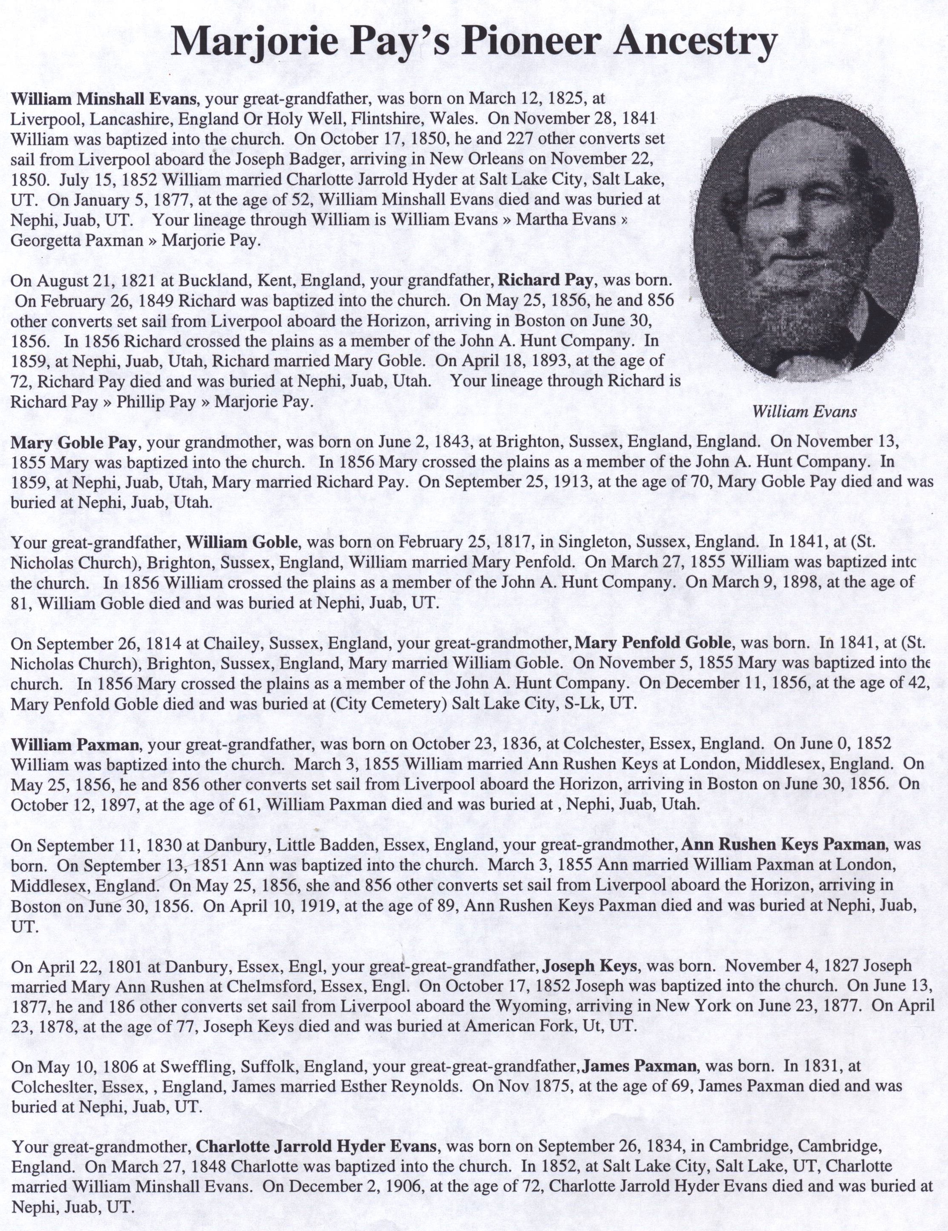

Slide 5
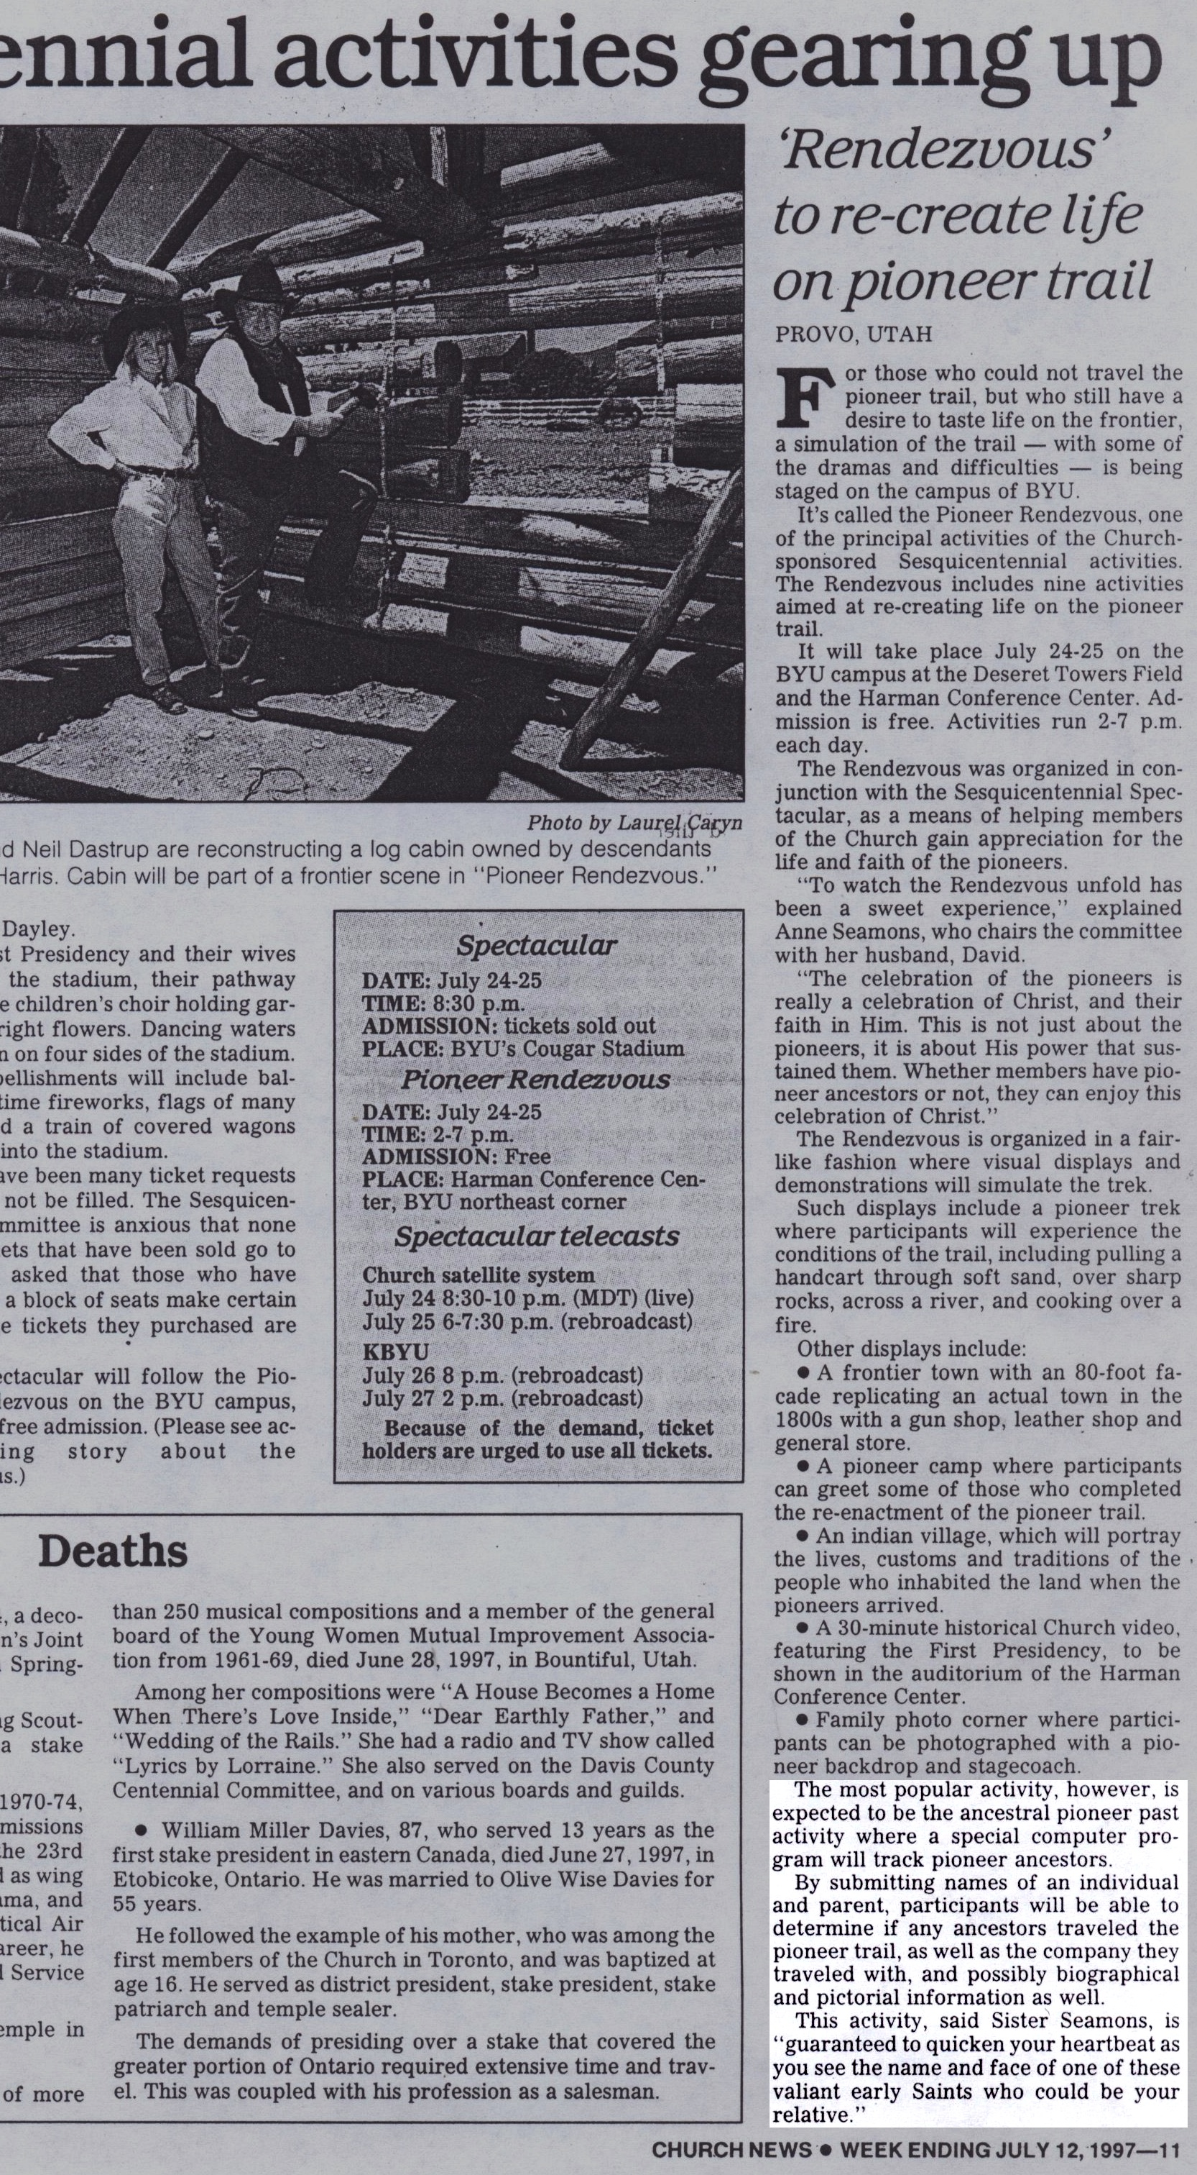
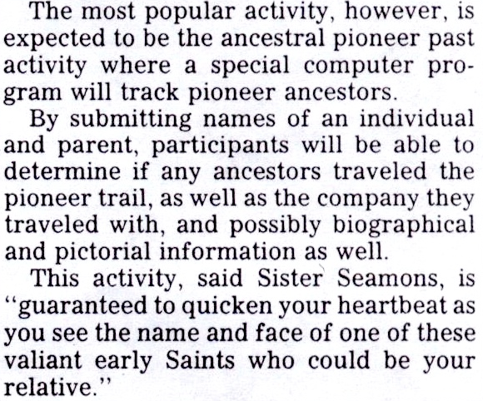

Slide 6
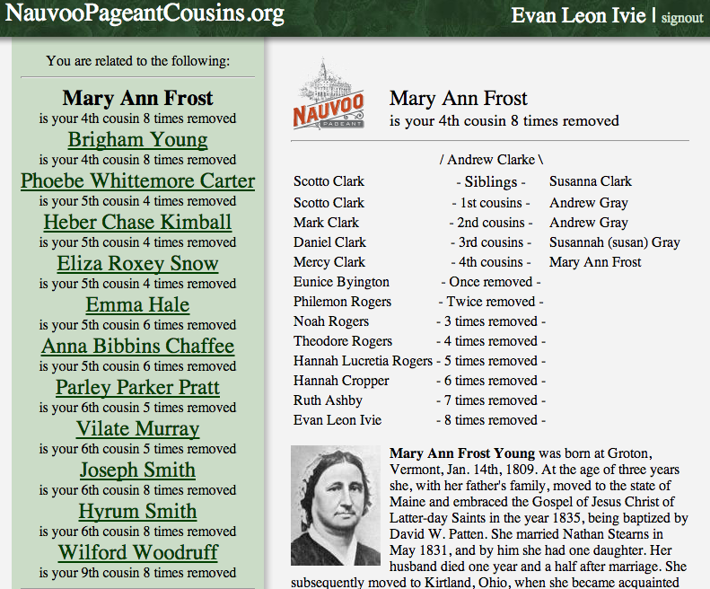

Slide 7
Human Interest in Genealogy
Intergenerational Identity
Brotherhood
Interest in Places and Events
Sense of Familiarity

Slide 8
Individual/Family Identity
Emory University Research
FamilySearch Family Tree
Living People
Young People
Primary and Youth in Family History Centers

Slide 9
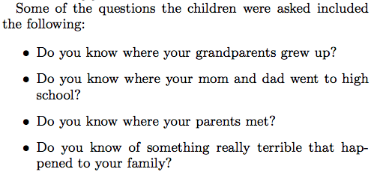
Emory University Research on Family

Slide 10
Brotherhood
General Authorities
Wards
Other groups
Individuals

Slide 11
Interest in Places and Events
Utah Sesquicentennial
Founding of Nauvoo
Jamestown Anniversary
Lincoln Museum

Slide 12
Other Possible Efforts
GPS tour of Nauvoo
Genealogical Kiosks
Extended Family Ordinance Card

Slide 13
